Slide 1
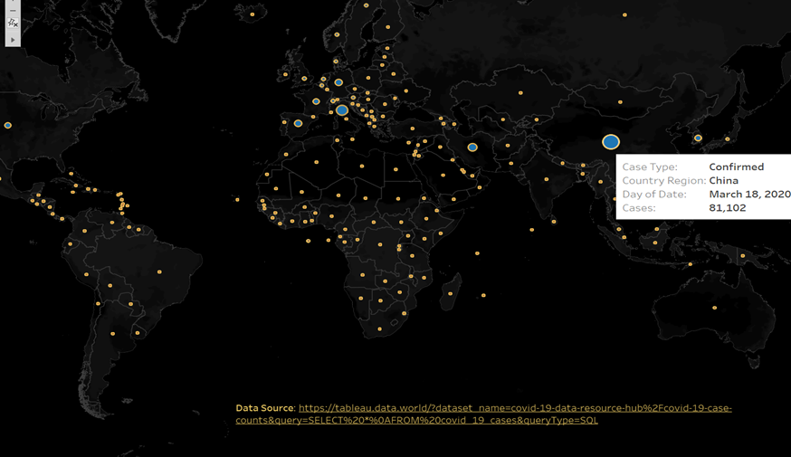
ORIGIN & SPREAD OF COVID-19
The first case was reported in China, by 18th March China had the most confirm cases.

Slide 2
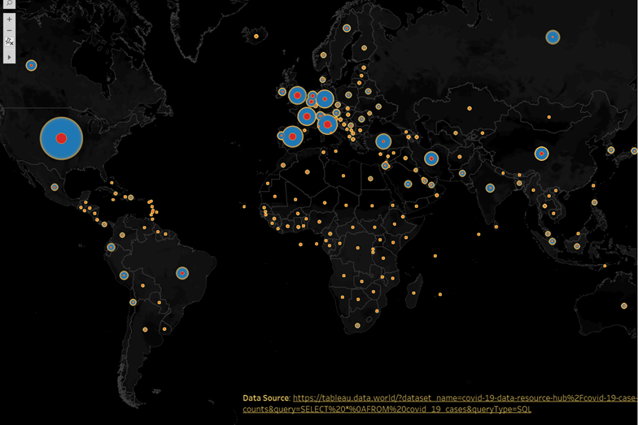
COUNTRIES AFFECTED
Growth of Death and Confirm cases around the world.
RED: Deaths cases in a country.
Blue: Confirm cases in a country.

Slide 3
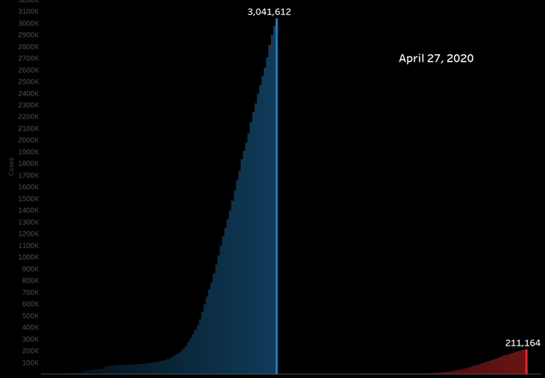
Total no. of Confirmed and Death cases
Growth in no. of Death and Confirmed cases with the increase in time.
On April 27, 2020 there are a total of 3,041,612 Confirmed cases and 211,164 Death cases.

Slide 4
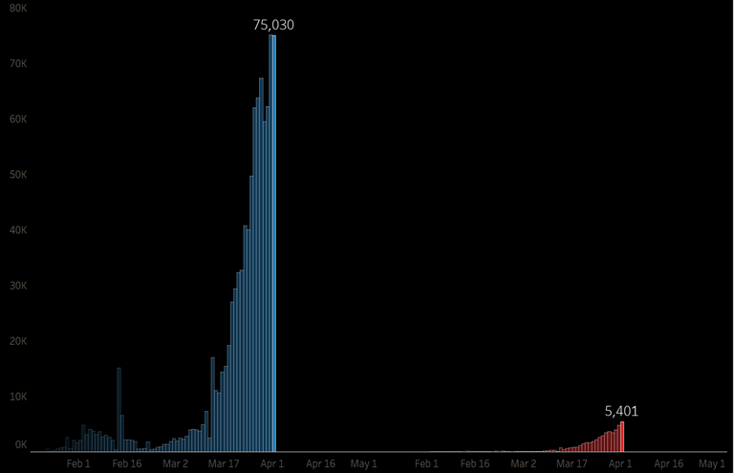
Death and Confirmed cases projected per day.
Reported cases of COVID-19 globally as of April 1st 2020.

Slide 5
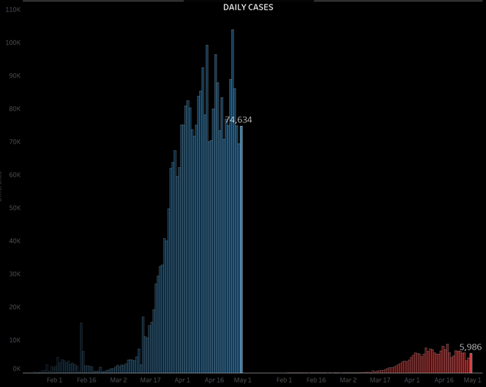
No. of Cases according to each day.
The no. of cases per day help to understand the curve.
April 24 had the maximum number of (103,861) confirmed cases.
April 17 had the maximum number of (8,771)death cases.

Slide 6
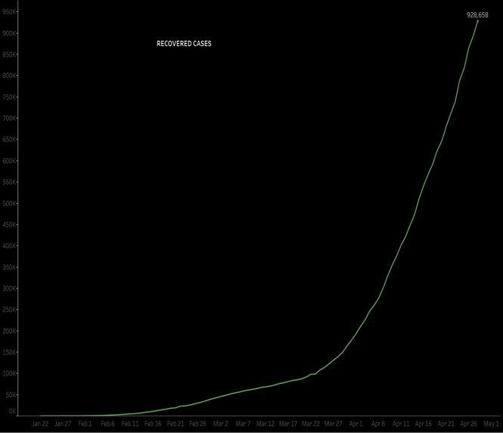
No. of Cases Recovered from the Infection.
Total 928,658 cases recovered from the infected till April 27,2020

Slide 7
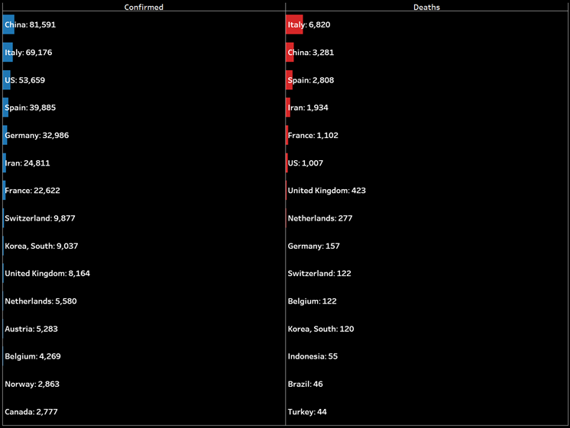
TOP 15 COUNTRIES WITH HIGHEST NUMBER OF CASES
CHINA WITH HIGHEST NUMBER OF CONFIRM CASES.
ITALY WITH HIGHEST NUMBER OF DEATH CASES.

Slide 8
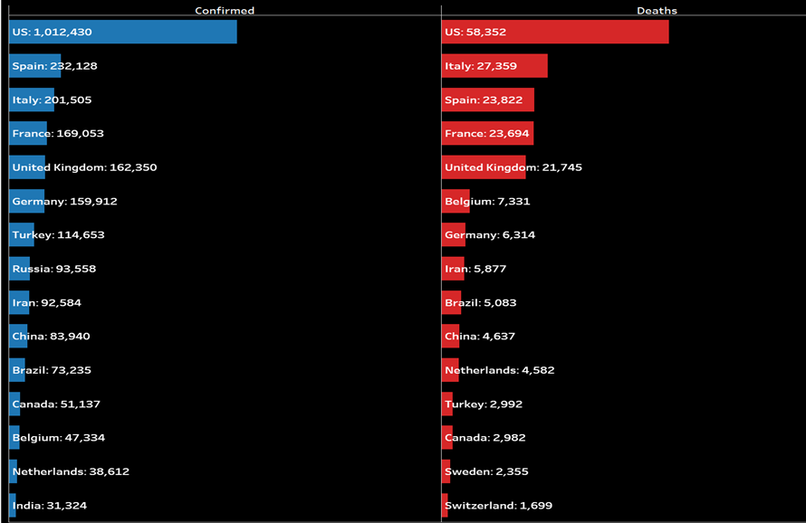
MOST AFFECTED COUNTRIES
BY APRIL 27, 202O USA HAS THE HIGHEST NO. OF CONFIRMED & DEATH CASES.

Slide 9
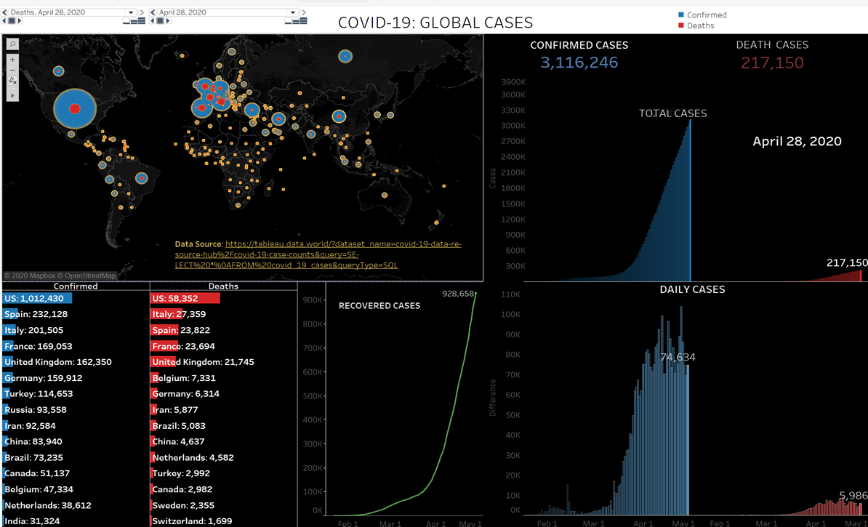
DASHBOARD-1

